Slide 1
Economic Indicators of Crime
By Ryan Francis and Joshua Baker

Slide 2
Research Question
We were interested in finding out what was the economic indicators of crime
Economic inequality
Poverty
Urbanization
Our theory is that as economic inequality and poverty increased the crime rate would also increase

Slide 3
Motivation
To find out what the actual impact of economic inequality is
Economic inequality has become a bigger topic in civil discourse, therefore it is worthwhile to take a more analytical look at its actual impact
To measure the effect of income inequality on crime
Crime is a threat to every member of society, knowing what contributes to its occurrence is helpful into informing what possible remedies would be appropriate

Slide 4
Data Sources
We assembled a panel from the years 2010-2017 of all 50 states
All of our crime data came from the FBI’s website
Property crime
Violent crime
Population density
The Economic data came from the US Census Bureau
Gini Coefficient
Median Income

Slide 5
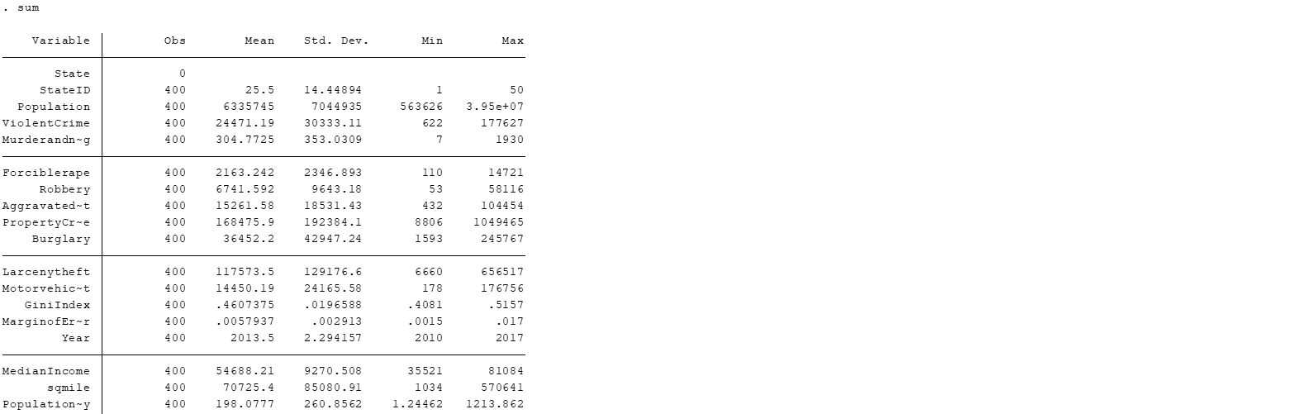
Summary Statistic

Slide 6
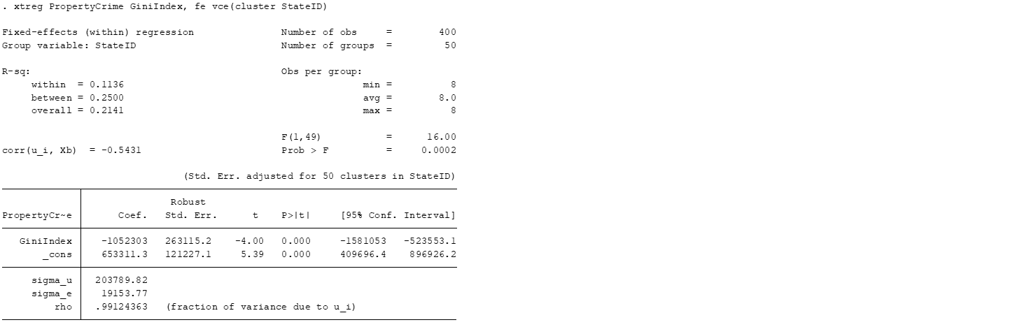
Main Model
Main Points to look at
R Squared
P-Value
Interpet the Coeff.

Slide 7
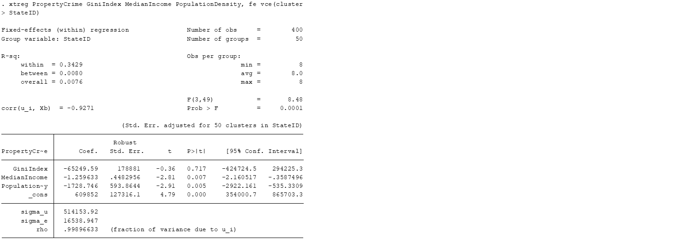
Property Crime Regression
Main Points to look at
R Squared
P-Value
Interpet the Coeff.

Slide 8

Violent Crime Regression
Main Points to look at
R Squared
P-Value
Interpet the Coeff.

Slide 9
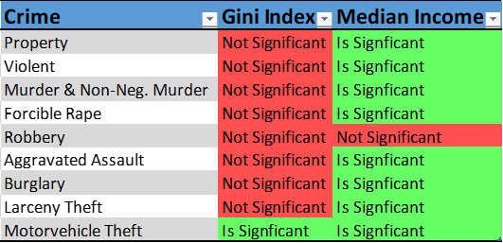
Overview of Gini Significance

Slide 10
Possible Biases (Covariates we left out)
Gini Index and Median Income could be related
Number of single parents per state
We couldn’t find a good data source for this
Societal Cohesion
It would be difficult if not impossible to measure
Number of Repeated Offensives
Psychological Attitude or Thought Process
Essentially, any variable that would make it more likely to commit a crime

Slide 11
Conclusion
We did not have enough evidence to show that economic inequality increases crime
The evidence suggests that absolute income is more important
If we were to the project again, we would focus on median income as our prime independent variable and brainstorm more possible variables

Slide 12
Questions?

